Slide 1

HTML
Lesson 5

Slide 2
HTML – Forms
<form>
.......
</form>
HTML forms are used to pass data to a server.
Tag | Description
<form> | Defines an HTML form for user input
<input> | Defines an input control
<textarea> | Defines a multiline input control (text area)
<label> | Defines a label for an <input> element
<fieldset> | Groups related elements in a form
<legend> | Defines a caption for a <fieldset> element
<select> | Defines a drop-down list
<optgroup> | Defines a group of related options in a drop-down list
<option> | Defines an option in a drop-down list
<button> | Defines a clickable button

Slide 3
HTML – Forms
The Input Element:
The <input> element is used to select user information.
<form>
First name: <input type="text" name="firstname"> <br>
Last name: <input type="text" name="lastname">
</form>
1.
<form>
Password: <input type=" password " name="password">
</form>
2.

Slide 4
HTML – Forms
The Input Element:
<form>
<input type= "radio" name="gender" value="male" > Male<br>
<input type= "radio" name ="gender" value="female" >Female
</form>
3.
<form>
<input type= "checkbox" name="vehicle1" value="Bike" >
I have a bike<br>
<input type= "checkbox" name="vehicle2" value="Car" >
I have a car
</form>
4.

Slide 5
HTML – Forms
The Input Element:
<form>
<input type= "button" value= " Hello World!" >
</form>
5.
A submit button is used to send form data to a server.
<form action="html_form_action.php" method="get" >
Username: <input type="text" name="user">
<input type="submit" value="Submit">
</form>
6.

Slide 6
HTML – Forms
Textarea:
<textarea rows="10" cols="30" name= " message" >
The cat was playing in the garden.
</textarea>
Select:
<form >
  <select name="cars">
    <option value="volvo">Volvo</option>
    <option value="saab">Saab</option>
    <option value="fiat">Fiat</option>
    <option value="audi">Audi</option>
  </select>
</form>

Slide 7
HTML – Forms
Select (optgroup):
<form >
  <select name="cars">
  <optgroup label="Swedish Cars">
    <option value="volvo">Volvo</option>
    <option value="saab">Saab</option>
    </optgroup>
    <optgroup label="German Cars">
    <option value=“mercedes">Mercedes</option>
    <option value="audi" > Audi</option>
    </optgroup>
  </select>
</form>

Slide 8
HTML – Forms
Fieldset
<form >
<fieldset>
    <legend> Personal information: </legend>
    Name: <input type="text" size="30"> <br>
    E-mail: <input type="text" size="30"> <br>
    Date of birth: <input type="text" size="10">
</fieldset>
</form>

Slide 9
HTML – Forms
Selected and checked:
<form>
<input type= "radio" name= "gender" value="male" checked="checked" > Male<br>
<input type= "radio" name= "gender " value="female" >Female
</form>
<form>
<input type= "checkbox" name= "a1" value= "Yes" checked="checked" > Yes<br>
<input type= "checkbox" name= "a2" value= "No" > No <br>
<input type= "checkbox" name= "a3" value= "maybe" >Maybe
</form>

Slide 10
HTML – Forms
Selected and checkted:
<form >
  <select name="cars">
    <option value="volvo" >Volvo</option>
    <option value="saab">Saab</option>
    <option value="fiat" selected="selected" >Fiat</option>
    <option value="audi">Audi</option>
  </select>
</form>

Slide 11
HTML – Forms
Labels:
<form >
<label for="firstname" > Firstname</label>
<input type="text" name="firstname" id="firstname">
<br>
<label for="lastname">Lastname</label>
<input type="text" name="lastname" id="lastname">
<br>
<label for="male">Male</label>
<input type="radio" name= "gender" id="male" >
<label for="female">Female</label>
<input type="radio" name="gender" id="female" >
<br>
<input type="submit" value="Submit">
</form>

Slide 12
HTML – Forms
Some attributes:
<form >
<label for="firstname" >Firstname</label>
<input type="text" name="firstname" id="firstname" required >
<br>
<label for="country">Country</label>
<input type="text" name= " country "
id= " country" maxlength= "5" readonly value= "country " >
<br>
<input type="reset" value="Reset">
<input type="submit" value="Submit">
</form>

Slide 13
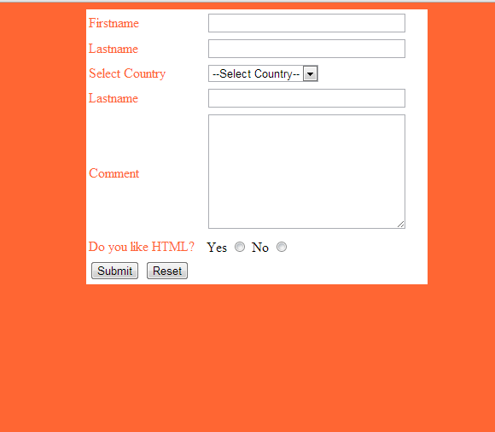
Task1:

Slide 14
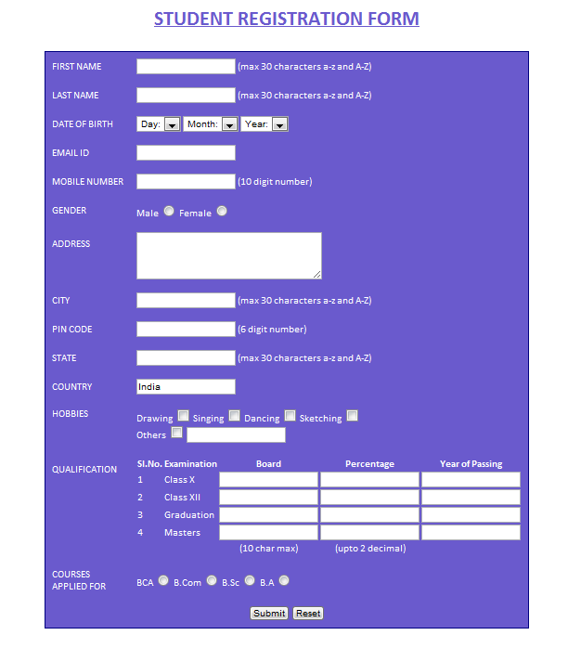
Task 2:

